Slide 1


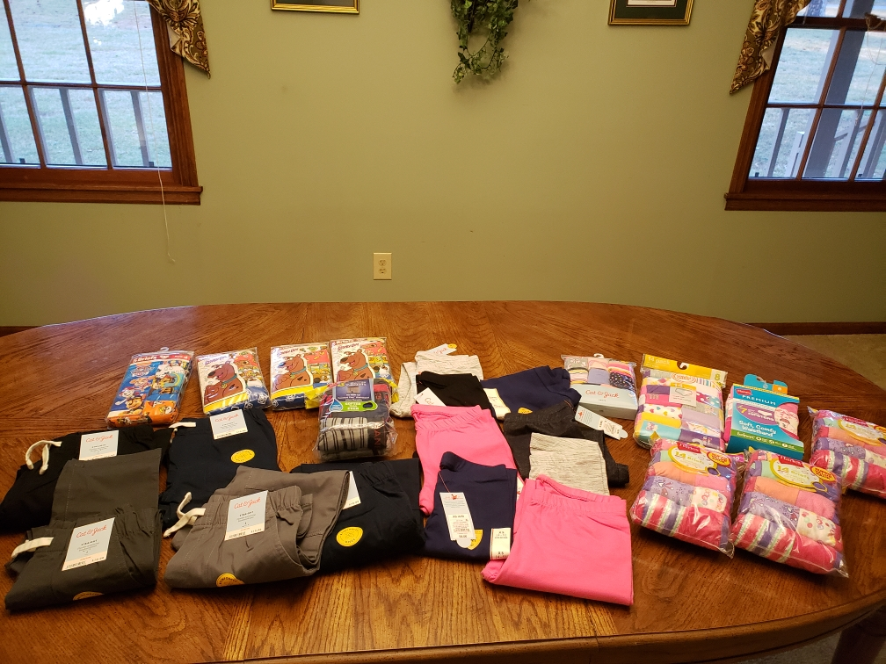
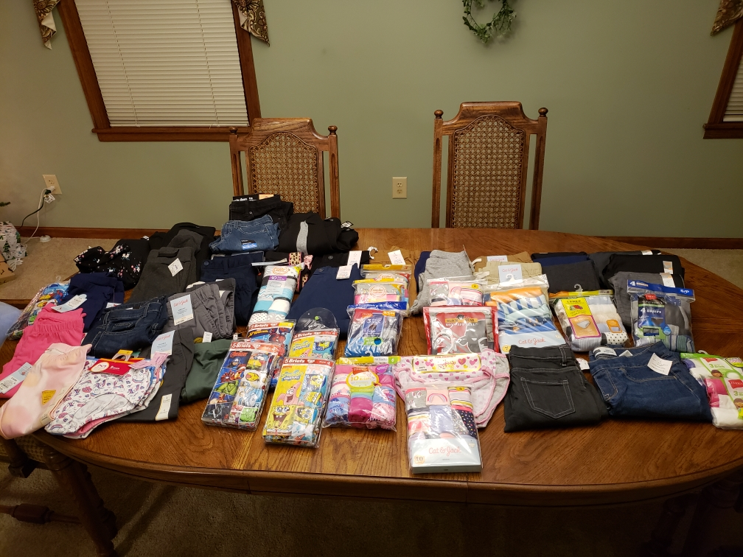

JOY MISSION CHURCH Newsletter
Joy on mission…the hands and feet of God!
Pelion Elementary Clothing Drive Bottoms only clothing drive - donations of new boys & girls pants & underwear.
Pelion, SC
Congo
We are NOT the mission. Our mission as a member of the body of Christ is to live the Great Commission.
“And Jesus came and said to them, “All authority in heaven and on earth has been given to me. Go therefore and make disciples of all nations, baptizing them in the name of the Father and of the Son and of the Holy Spirit, teaching them to observe all that I have commanded you. And behold, I am with you always, to the end of age.” (Matthew 28:18-20)

Slide 2
Love God. Love neighbor.
Serve with Joy in Jesus’ name.
PASTOR’S CORNER
“You are the light of the world. A city set on a hill cannot be hidden. Nor do people light a lamp and put it under a basket, but on a stand, and it gives light to all in the house. In the same way, let your light shine before others, so that they may see your good works and give glory to your Father who is in heaven.” (Matthew 5:14-16)
We have a choice. We can choose to see this challenging time in history as terrible and miserable, filled only with the darkness of anxiety, unrest, and fear, OR we can see it as our golden opportunity to shine the light of Christ into that darkness.
In Christ, we be His lights to the world, bringing peace, calmness, and faith wherever we are. Now is our time to SHINE, and as God’s Word reminds us, “The light shines in the darkness, and the darkness has not overcome it.” (John 1:5)
This monthly newsletter will hopefully serve as a reminder that God is still in charge and in control, and that through Joy, He is doing awesome and wonderful things! Let us live in the joy, hope, and light of our Lord.
Pastor Paulette
Joy Mission Church
200 Merrimac Court
Lexington, SC 29072
Return Receipt Requested
January 2021
UPCOMING EVENTS

